Slide 1


GPU ACCELERATION OF A K-MEANS CLUSTERING ALGORITHM
ABDULAZIZ AL SHEHRI
AYMAN QASHLAN
HAYTHAM ALBETAIRI
DATE OF SUBMISSION
11/12/2023

Slide 2
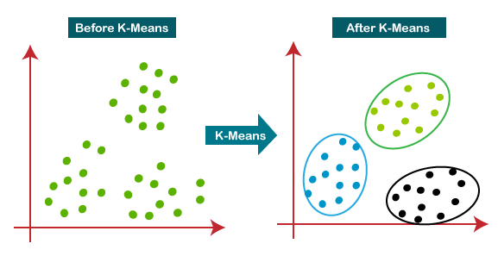
OVERVIEW
Machine learning algorithm used for partitioning a dataset into K clusters.
Each data point belongs to the cluster with the nearest mean (centroid).
Iteratively, refines the cluster centroids
based on the mean of the data points
assigned to each cluster

Slide 3
OVERVIEW
Applications in various fields, such as data analysis, image segmentation, and customer segmentation, providing insights into patterns within datasets.
The computational intensity can be a bottleneck, slowing down performance and hindering real-time processing.
GPU acceleration techniques used to enhance
the performance of the algorithm.

Slide 4
APPROACH
Sequential
The foundational algorithm for our project is the traditional K-Means clustering.
This choice is grounded in the simplicity and interpretability of the K-Means algorithm making it a widely-used and well-understood method for unsupervised clustering.
It provides a baseline for comparison and sets the stage for optimization.
OpenACC, CUDA Python, and CUDA C/C++, were used to GPU accelerate the Algoriethim.

Slide 5
APPROACH
Sequential Algorithm
Data Loading
K-means Initialization
K-means Clustering
Output Data

Slide 6
APPROACH
Sequential Code Evaluation
Function | Time (Sec) | Percentage
Read Data | 0.356 | 0.67%
K-Means Initialization | 0.715E-03 | 0.0013%
K-Means Execution | 52.15 | 98.8%
Output Data | 0.3 | 0.57%
Total Time | 52.75 | -

Slide 7
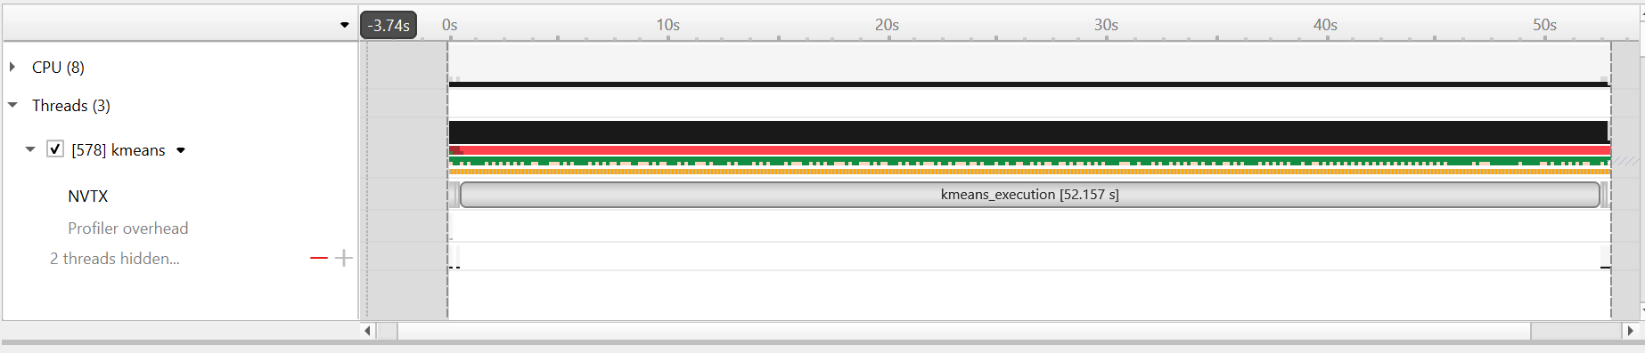
IMPLEMENTATION
Sequential Profiling

Slide 8
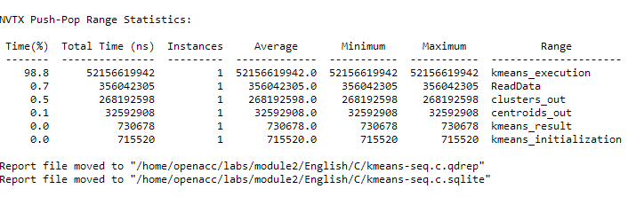
IMPLEMENTATION
Sequential Profiling
K-means Execution function takes 98.8% of total execution time.
Parallelization is focused to K-means Execution function.

Slide 9
APPROACH
Open Acc
OpenACC was chosen as a parallelization framework due to its ease of use and compatibility with GPUs.
Its directives allow for straightforward integration of parallel computing capabilities without extensive code modifications.
This choice was motivated by the desire to tap into the parallel processing power of GPUs efficiently.

Slide 10
IMPLEMENTATION
Open ACC
Focus on K-means Execution function (98.8% of execution time).
The function has 5 loops in a while loop and a single for loop.
Studied the timing of each loop to determine bootlicks. Shown Next
Performed Managed and structured data management penalization.

Slide 11
IMPLEMENTATION
K-means Execution Function
Loop | Percentage
L1 – Sum Reset | 0
L2 – Cluster count Reset | 0
L3 – Compute Distance | 95.50
L4 – Computes Centroids | 0.00
L5 – Compute Delta | 0.00
L6 – Assign to Clusters | 4.50

Slide 12
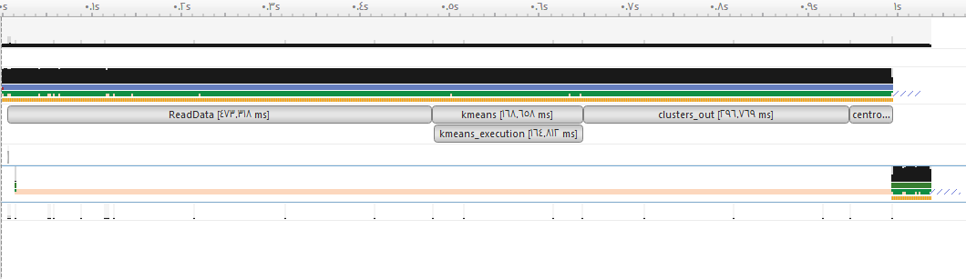
Implementation
Profiling Open ACC – Managed

Slide 13
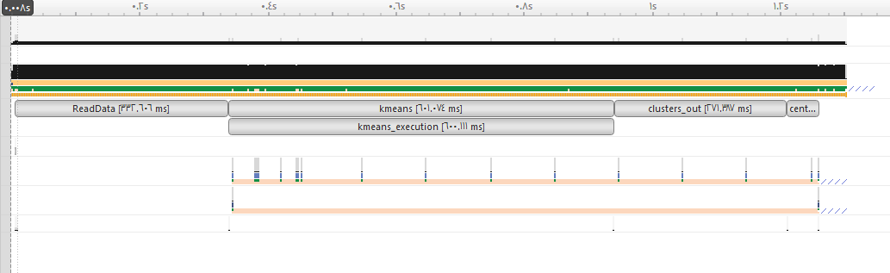
Implementation
Profiling Open ACC – Structured

Slide 14

APPROACH
CUDA Python
To cater to the Python-centric ecosystem, CUDA Python is incorporated into the project using Python Numba
This approach enables seamless integration of GPU acceleration within Python scripts.
Python prevalence within the machine learning community, is a pivotal motivation for incorporating Python acceleration into our project.

Slide 15
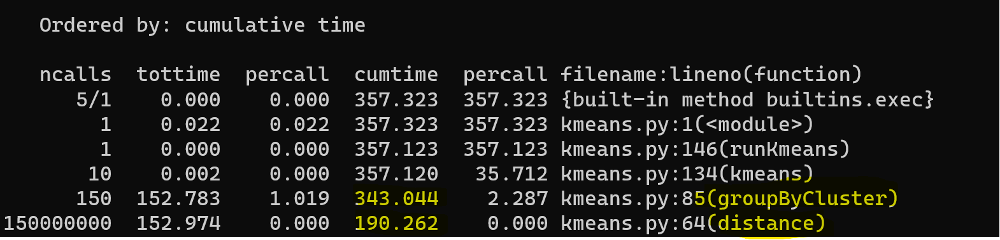
Implementation
CUDA Python – sequential profiling
Most time is spent in groupByCluster and distance functions.
Parallelization will mainly focus on these two functions

Slide 16
Implementation
CUDA Python
Nvidia Tesla T4 GPU was used
Used @cuda.jit( … device='gpu') decorator on multiple functions
Changed class objects to 2d arrays to represent point and cluster objects
Numba does not support class objects arrays
Handled data transfer to Device (and back to host)
Example: d_Points = cuda.to_device(Points)
Used shared memory to optimize performance
Example: s_Cluster_Num_Points = cuda.shared.array(shape=(num_threads, 2), dtype=float32)
Each block caches its output to the shared memory, then data is consolidated from all shared arrays into device memory array

Slide 17
APPROACH
CUDA C/C++
CUDA C/C++ is employed to provide a more fine-grained control over GPU resources.
CUDA is highly optimized for NVIDIA GPUs and allows for low-level programming to maximize performance.
This technique addresses specific optimization needs that might not be fully achievable with higher-level abstractions.
More involved memory management by the developer implies more complex code

Slide 18
IMPLEMENTATION
CUDA C/C++
Host Reads data from file.
Two primary functions running as kernels.
kmeans-init()
kmeans-execution()
Three arrays that need management between Host and Device.
int* data_points
int* cluster_points
float* centroids
Devices moves data back to host after calculation.
Host writes the data back to files.

Slide 19
RESULTS
Implementation | Execution Time (Seconds) | Speedup
Sequential | 52.8 | -
Open ACC– Managed | 0.95 | 55.6
Open ACC– Structured | 1.26 | 41.9
CUDA Python | 0.602 | 87.7
CUDA C/C++ | – | –

Slide 20
COMPARATIVE ANALYSIS SLIDE

Slide 21
COMPARATIVE ANALYSIS SLIDE

Slide 22
Conclusion Slide
Python Numba-Cuda availed the greatest speedup
Using shared memory arrays as cache
Numba Just-In-Time complier does internal optimization by default
Open acc and CUDA Python require less explicit optimisation from the developer.
CUDA C++ is more difficult to optimise compared to other techniques.

Slide 23
FUTURE WORK SLIDE
Test with more advanced GPUs.
Test with larger dataset \ number of clusters.
Use unstructured data management model for open acc implementation.
Use data prefetching to enhance the performance.

Slide 24


